Slide 1
Regression Tree
Team 2-11
Robert Catlett, Rebecca Duan, Casey Terrel, Nanxi Wang
Notes:
Hello everyone, we are team 11. My name is ... Today we are going to talk about regression tree.

Slide 2
Agenda
Idea of Tree
Decision Tree
Graphs and Terminology
Regression Tree
Main Idea
Realization
Splitting Methods
Pruning Methods
Examples
Notes:
First, I will start with the general idea of “tree” and introduce the tree-based method for regression. My group members will talk about its realization in R.

Slide 3
Idea of Tree

Slide 4

Decision Tree in Daily Life
Should I bring an umbrella / a rain jacket / nothing today?
Notes:
Here is an example of decision tree in our daily life. It has been raining recently. Before walking out of your door, have you thought if you should bring an umbrella, rain jacket or nothing?

Slide 5
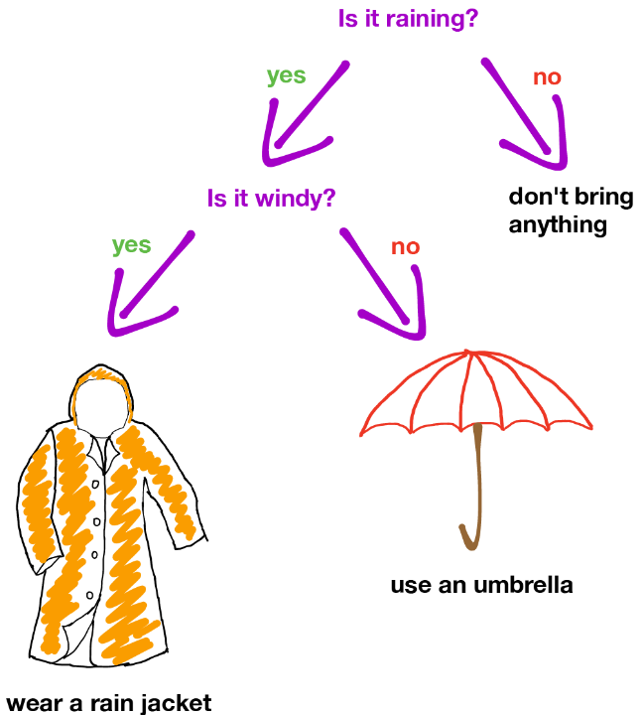
Notes:
Here is the decision tree that people made in their mind but didn’t realize.
If it’s not raining, nothing is needed. If it’s raining but not windy, an umbrella is good to go. If it’s windy and rainy, you’d better wear a rain jacket.
Image Source: https://ml.berkeley.edu/blog/2017/12/26/tutorial-5/

Slide 6
A decision tree is a decision support tool that uses a tree-like model of decisions and their possible consequences.
Notes:
From this example it’s easy to see that decision tree’s attraction lies in the simplicity of the resulting model, where a decision tree is quite easy to understand and explain.
This definition tells us “what a decision tree serves” and “when to use a decision tree”.

Slide 7
Terminology
Root Node
Subtree /Branch
Region 1
Internal Node
Terminal Node/Leaf 3
Region 3
Region 2
Terminal Node/Leaf 1
Terminal Node/Leaf 2
Notes:
Now let’s talk about terminology in decision tree.
Left figure is an example of decision trees, which are typically drawn upside down, in the sense that the leaves are at the bottom of the tree.
A decision tree starts with a single root node that splits into multiple branches, leading to further nodes, each of which may further split as internal nodes, or else terminate as terminal nodes. Associated with each non-terminal node will be a test or question that determines which branch to follow. The terminal nodes contain the "decisions" or "predictions" and the number in each terminal node is the mean of the response of the observation that fall there.
Right figure is a three-region partition from the decision tree illustrated in the left figure. In keeping with the tree analogy, the individual regions are known as terminal nodes or leaves of the tree.
add number

Slide 8
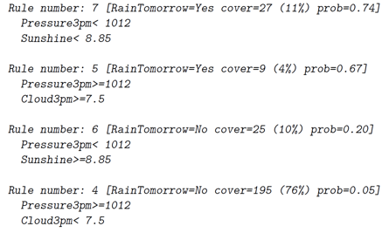
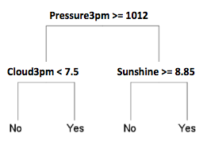
Making Rules From Trees
5%
67%
20%
74%
Notes:
The decision tree translates to the rule set, where each rule corresponds to one pathway through the decision tree, starting at the root node and terminating at a terminal node.
For example, consider rule 7: There are 27 data points that takes 11% of the total data. For 74% of these 27 observations (prob=0.74), it rained the following day (RainTomorrow=Yes) when the pressure at 3pm was less than 1012 and the hours of sunshine were less than 8.85)
Probabilities are typically recorded for each terminal node to indicate the strength of the decision we derive from the model.
It should be noted that since large trees are often simplified by cutting back (or pruning), we will often see rule numbers that are not sequential.
1. need to reconstruct the tree
2. include "rules"
3. explain why rule numbers are usually not sequential
4. probability associated with each leaf node

Slide 9
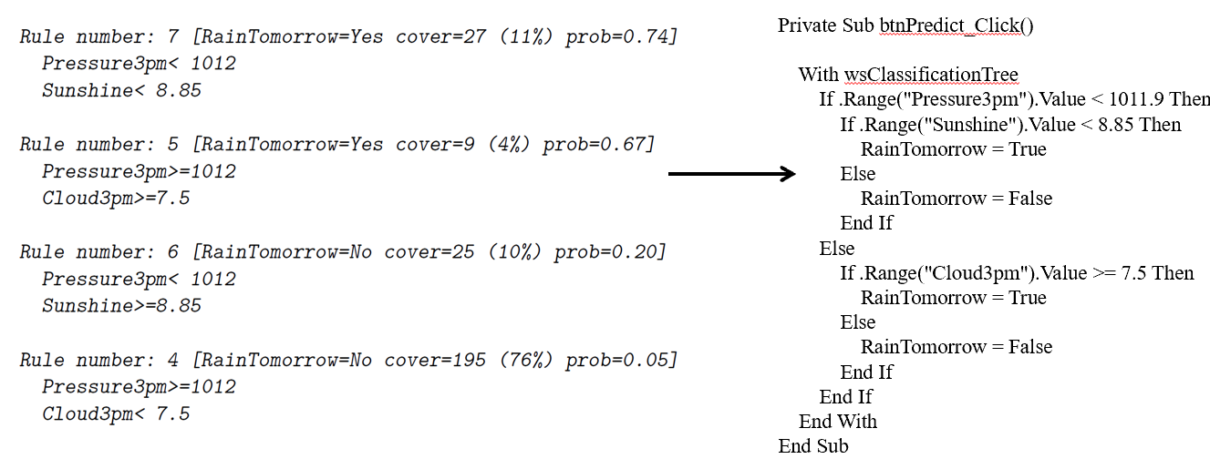
Decision Tree in Coding Logic
Notes:
Also, observe how readily a decision tree is converted to code. Each rule can be converted to an if-statement.
This example is a classification example since its response variable is categorical. We are using it for our presentation on regression because it provides an easy-to-explain example of the general idea of the tree structure. We will apply the concept to a regression problem later in the presentation.
It might seem like classification-yes/no-binary, but our group’s focus is regression-prediction numeric value.
how they came about
partition sample
group of samples-terminal node 80%yes 20%no
decesion tree:1;2 type of depend
lost use classification
but we are actually regression
tree building
how spliting occurs
(For example, consider rule 7: For 74% of the observations (prob=0.74), it rained the following day (RainTomorrow=Yes) when the pressure at 3pm was less than 1012 and the hours of sunshine were less than 8.85)

Slide 10
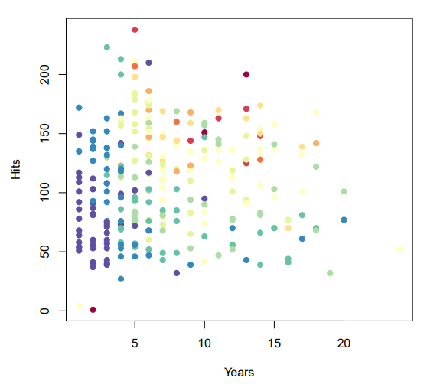
Prediction of baseball player’s salary
Notes:
Besides helping to make decisions, decision tree can also help to make predictions, which means the terminal node could contain decision or prediction.
For example, the log salary of a baseball player is based on the number of years that he has played and the number of hits that he made in the previous year, As the graph indicates, log salary depends on #years and #hitts. The warmer tone the dots have, the higher the log salaries are.
Would you be able to predict his salary given Years and Hits?
How many years or how many hits do you think do you think would make a difference in log salary?

Slide 11
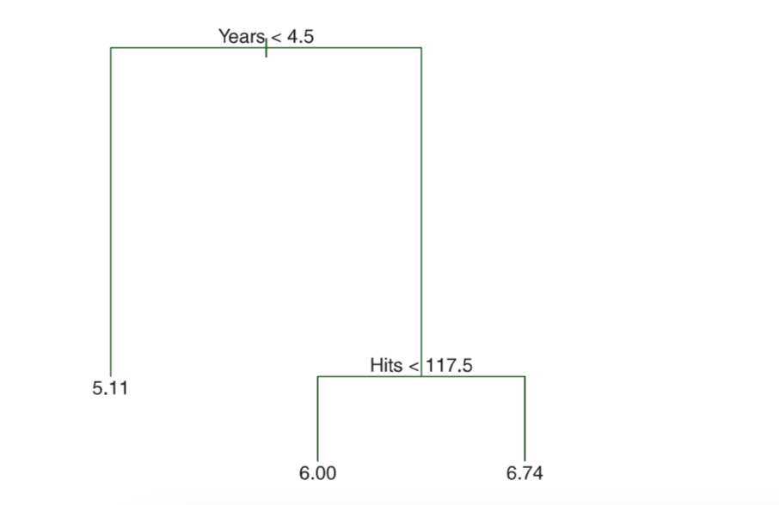
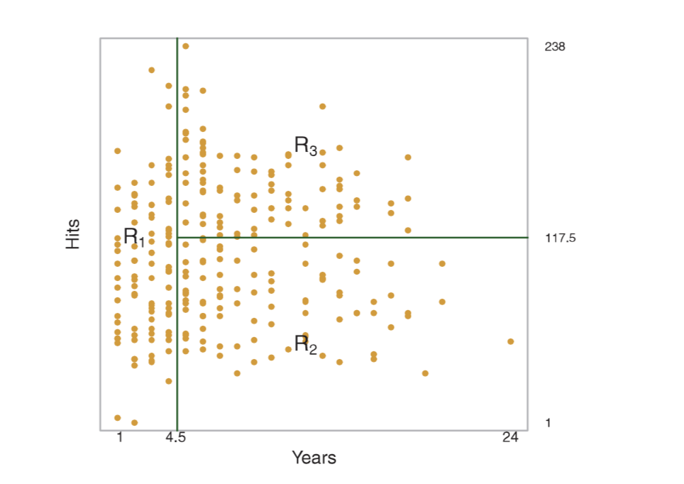
Interpretation of baseball player’s salary
Figure 1 Figure 2
1. R1 = X | Years < 4.5
2. R2 = X | Years ≥ 4.5, Hits < 117.5
3. R3 = X | Years ≥ 4.5, Hits ≥ 117.5.
Notes:
Here is the answer.
Figure 1 is a regression tree for predicting the log salary of a baseball player. There are a series of splits starting at the top of the tree. The top split assigns observations having Years < 4.5 to the left branch. The predicted salary for these players is given by the mean response value for the players in the data set with Years < 4.5. For such players, the mean log salary is 5.11, and so we make a prediction of e 5.11 thousands of dollars, i.e. 165, 174.
Figure 2 is a three-region partition for the Hitters data set from the regression tree illustrated in Figure 1.
An interpretation of these two figures is: Year is the most important factor in determining Salary, and players with less experience earn lower salaries than more experienced players. Given that a player is less experienced, the number of hits that he made in the previous year seems to play little role in his salary. But among players who have played for five or more years, the number of hits made in the previous year does affect salary, and players who made more hits last year tend to have higher salaries.
pointer
Next Nanxi will tell us more about regression tree.

Slide 12
Regression Tree
Main Idea

Slide 13
Stratify the predictor space into a number of simple regions, then use the mean for the training observations in the region to which it belongs

Slide 14
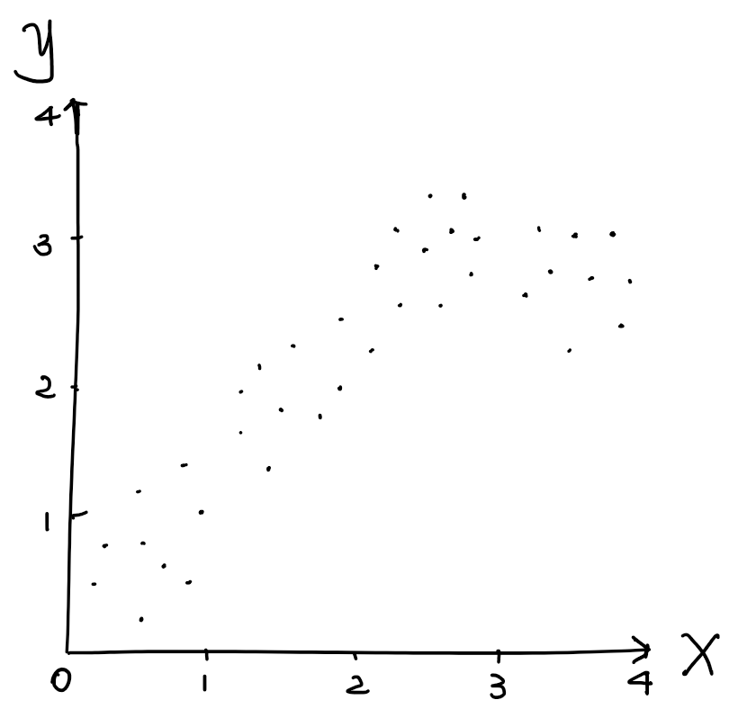
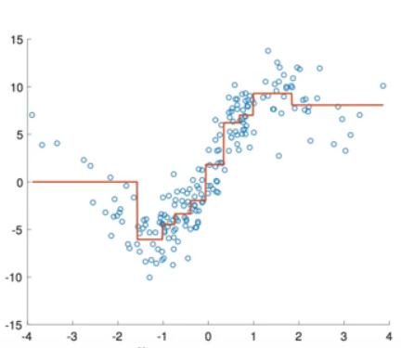
Decision Tree to Tree Regression
mean y 3
mean y 4
mean y 2
y hat = 3
mean y 1
Notes:
Is it possible to visualize the tree regression?

Slide 15
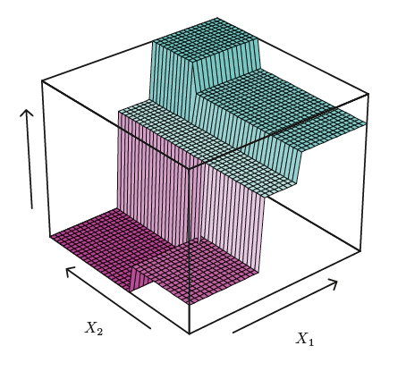
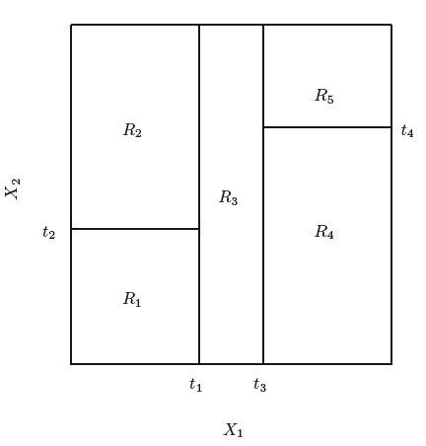
Tree Map to Tree Regression
R5
R3
R2

Slide 16
Regression and Classification Trees
Regression Tree
yi is continuous
Classification Tree
yi is discrete (yi ∈ {1, 2, ...j})
Notes:
Decision trees can be applied to both regression and classification problems. we only focus on regression tree, the other group will talk about classification tree

Slide 17
Basic Idea of Regression Tree
the set of splitting rules used to segment the predictor space can be summarized by a tree
Pro: simple and useful for interpretation
Con: not competitive with the best supervised learning approaches in terms of prediction accuracy

Slide 18
Regression Tree
Realization Step 1 : Stratify the samples / grow a tree
Notes:
Thank you Nanxi for that introduction on regression trees. Now that we have a good understanding of its basic concept, and some advantages for using this approach over other models, it is important to understand how we build the regression tree by stratifying our sample into different predictor spaces.

Slide 19
Stratify a Regression Tree
Divide the predictor space - the Set of Possible Values for X₁, X₂, …, X_{p} - into J distinct and non-overlapping regions; R₁, R₂, …, R_{J}
For every observation that falls into the region R_{J}, we make the same prediction, which is simply the mean of the response values for the training observations in R_{J}.
Notes:
It is now time to consider at what point does one split the regression tree. To build the regression tree, there are roughly speaking, two steps to be followed. We want to divide the predictor space into non- overlapping regions which are then used to explain the data. The predictor space is the set of all possible values for all independent variables. When dividing the predictor space one can consider cutting or splitting the tree at any value for any predictor. That’s certainly a lot of possibilities.
Once these regions spaces are separated into groups it is now time to proceed to the next step. For every observation that falls into a specific region, we make the same prediction, which is simply the mean of the response values for the training observations in that particular region. Essentially, we are separating the predictor space into groups based on similar characteristics, and thus if the test data shares similar characteristics as those found in a particular group, we would predict it has a similar value for its dependent variable
The second step is

Slide 20
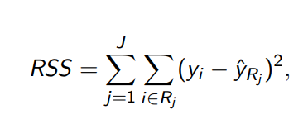
What Criteria Used for Splitting?
Minimize RSS
Notes:
Now we’ve already gone into detail, about how we want to split the tree, and that we want to use recursive binary splitting so to avoid the problem of trying to compute all possible tree designs. But we havent yet discussed which criteria we consider when splitting the tree. Like most regressions, we want to minimize the Residual Sum of Squares, since it is a good indicator of how well our model explains our data. Notice that this expression has a double summation symbol. Within each particular region, we want to compute the squared difference between the predicted values for the response value that falls within each region. You should also notice that predicted value, the y hat in the above equation, is the mean of the response values in that particular region, which brings us back to step 2. We are simply predicting the means of the response values for the training observations

Slide 21
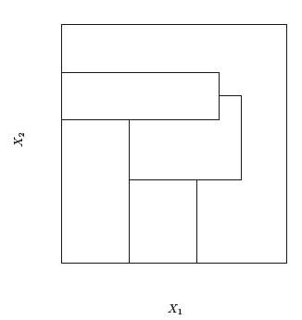
When to Split A Regression Tree?
In Theory, Predictor Space Can Have Any Shape
At Any Node Can Split By
Any Predictor At Any
Cutoff Value
Atypical Predictor Space
Notes:
It is now time to go further into Step 1 presented on the previous slide about when we split the regression tree. In theory, the predictor space can have any possible shape as one considers that at any given node one can split any predictor, that is any of the independent variables, at any possible cutoff point or value of a particular independent variable. Consider all these options would be immense, especially with large datasets with many predictor variables. The picture to the right on this slide indicates an atypical predictor space capturing two independent variables, x one and x two. It is an example of what we will not do to create our regression trees. Notice how the regions are nonrectangular which means that the predictor space has been split by considering variables at many different levels of the tree. We will go into this more on the next few slides and why this approach, considering all possible regression trees is not only a bad idea, but also more generally computationally infeasible

Slide 22
Consider All Possible Trees?
No, Computationally Infeasible
At Each Node Too Many Possible Splits to Consider
Notes:
Now my previous point bleeds over to this slide. When we attempt to build all regression trees by considering all options at which to split the regression tree into successive branches we run into an NP hard problem, which I presume many of our classmates will remember this concept from our optimization class. An NP-hard problem is computationally infeasible, it would take too long to consider all possible options to build this regression tree. To hone this point down, at why this is an NP hard problem I will go over to the board. Here is a regression tree (draws regression tree) split by two variables, x1 and x2. First we have to consider which variables produces the best initial split, perhaps its x1 or x2, and at which point, so we would have to consider splitting the tree at every x1 and x2 variable, and seeing whether that explains the data the best. Then at a lower node, you would consider splitting by either variable and every possible cutoff point again and seeing how that impacts

Slide 23
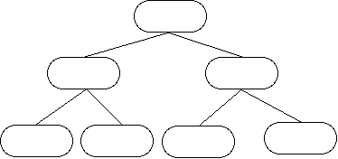
How to Split Regression Tree?
Use Recursive Binary Splitting
Top-Down
Move Down the Tree
Greedy
Look At Only
One Level At a
Time
Notes:
So if we dont or cannot consider all possible splits when producing a regression tree, what do we do instead? We should use a method known as Recursive Binary Splitting. Recursive binary splitting is a top-down, greedy approach that successively splits the tree into smaller and smaller branches, and can do this in a relatively quick span of time. We will see later on when Robert introduces the R section that splitting the tree does not take nearly any time in R; done in an instant.
Now lets discuss recursive binary splitting a bit further. It is a top down approach because it begins at the top of tree(at which point all observations belong to a single region) and then successively splits the predictor space, each split produces two more branches. We can see from the diagram on the slide that at each node, the tree splits further. We continue to work down the tree until we reach some terminal node determined by stopping criteria that we will mention later on.
This method is a greedy approach because at each step of the tree building process, the best split is made at that particular step, rather than looking ahead and picking a split that would lead to a better tree in some future step. So at the source of any intermediate node, when considering a split we will consider all possible values for all predictor variables, and see which cutoff point will produce the best model that can be used to explain the data

Slide 24
Recursive Binary Splitting
Select Predictor X_{J} and the cutpoint s such that splitting the predictor space into the regions {X|X_{J} < s} and {X|X_{J} > s} leads to the greatest possible reduction in RSS
Next, we repeat the process, looking for the best predictor and best cutpoint in order to split the data further so as to minimize the RSS within each of the resulting regions

Slide 25
Recursive Binary Splitting
Again, we look to split one of these new regions further, so as to minimize the RSS. The process continues until a stopping criterion is reached

Slide 26
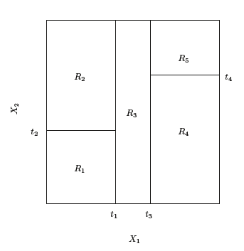
Recursive Binary Splitting
Notes:
Left: The output of recursive binary splitting on a two-dimensional example. (What we will be doing)
Right: A partition of two-dimensional feature space that could not result from recursive binary splitting.
The partition on the right side might generate better regression result and lead to a lower RSS, however, compared to Recursive Binary Splitting, it would be too computationally expensive. The feature of Recursive Binary Splitting is that it guarantees not the best but a not bad result and it’s efficient / time-consuming / computationally less expensive.

Slide 27
Predictions
We predict the response for a given test observation using the mean of the training observations in the region to which the test observation belongs

Slide 28
Excel Example
An Insight into Recursive Binary Splitting
Explaining Baseball Players’ Salaries
Notes:
How do we actually construct the regions?

Slide 29
Alternative Splitting Methods
Bottom - Up Approach
Oblique Decision Trees
Notes:
How do we actually construct the regions?

Slide 30
Regression Tree
Realization Step 2 : Avoid overfitting / prune the tree

Slide 31
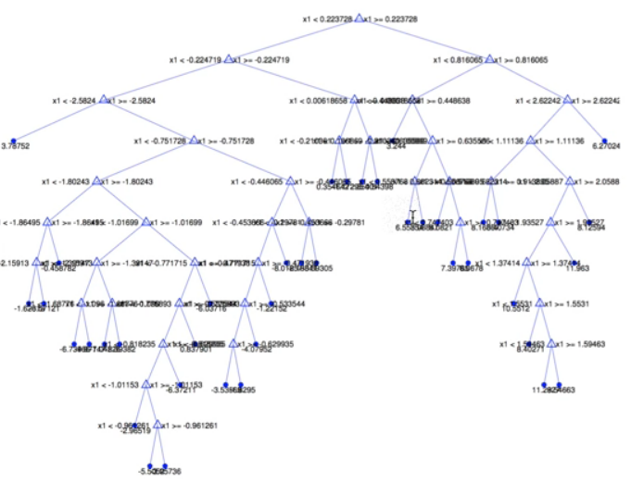
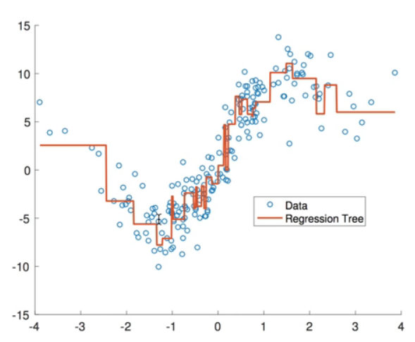
Problem of Overfitting
Notes:
The left hand side shows a giant decision tree with many leaves and the right hand side is the corresponding regression line. This may produce good predictions on the training set, but is likely to overfit the data, leading to poor test set performance.

Slide 32
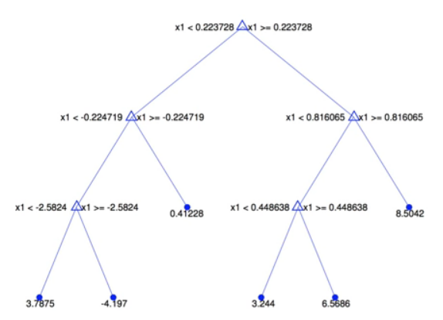
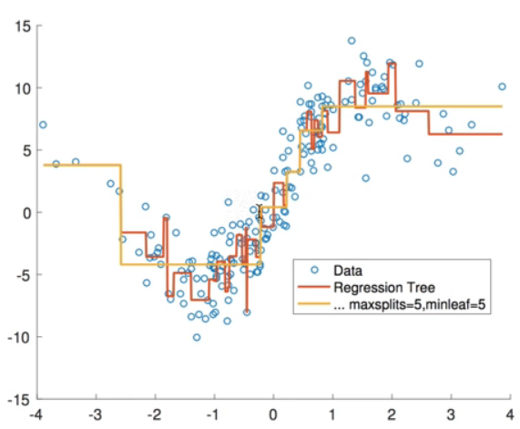
Problem of Overfitting
Notes:
These two charts shows the pruned tree and a new regression line with fewer splits. As here are only 5 splits and 6 leaves.
A smaller tree with fewer splits might lead to lower variance and better interpretation at the cost of a little bias.
As a result, we need to find a way to control the complexity of our model..

Slide 33
Methods to Solve Overfitting
Method 1: Grow a smaller tree
Grow the tree only when ΔRSS > threshold
Short-sighted
Method 2: Grow a large tree then prune it
Grow a very large tree T0
Prune it back in order to obtain a subtree
Notes:
One possible method to solve the overfitting problem is to grow the tree only so long as the decrease in the RSS of each split exceeds some high threshold. However, this method is short-sighted, because sometimes a worthless split may be followed by another split that results in huge reduction in RSS.
One strategy is to grow a very large tree T0, and then prune it back in order to obtain a subtree. We call it “Cost Complexity Pruning”. We use recursive binary splitting to grow a large tree on the training data, stopping only when each terminal node has fewer than some minimum number of observations, and then apply cost complexity pruning to the large tree in order to obtain a sequence of best subtrees.
###One possible alternative to the process described above is to grow the tree only so long as the decrease in the RSS due to each split exceeds some (high) threshold. However, this strategy will result in smaller trees, but is too short-sighted: a seemingly worthless split early on in the tree might be followed by a very good split — that is, a split that leads to a large reduction in RSS later on###

Slide 34
Pruning Method
Grow a large tree:
keep splitting until the model can’t be improved or there is only 1 observation in a leaf
Prune the tree :
cross validate every step
compare the error rates
but the lowest shouldn’t necessarily be used

Slide 35
Regression Tree
Realization in R

Slide 36
Steps
Create Maximal Tree
Find Appropriate Complexity Parameter (cp)
Prune Tree with Optimal CP
Predict on Test Set

Slide 37
Thank you!

Slide 38
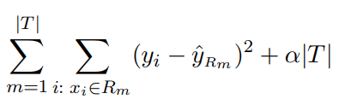
Cost Complexity Pruning
We consider a sequence of trees indexed by a nonnegative tuning parameter α.
add a penalty to the original RSS function
Minimize
Notes:
α is the tuning parameter
|T| indicates the number of terminal nodes of the tree T
Rm is the rectangle (i.e. the subset of predictor space) corresponding to the mth terminal node
ˆyRm is the mean of the training observations in Rm

Slide 39
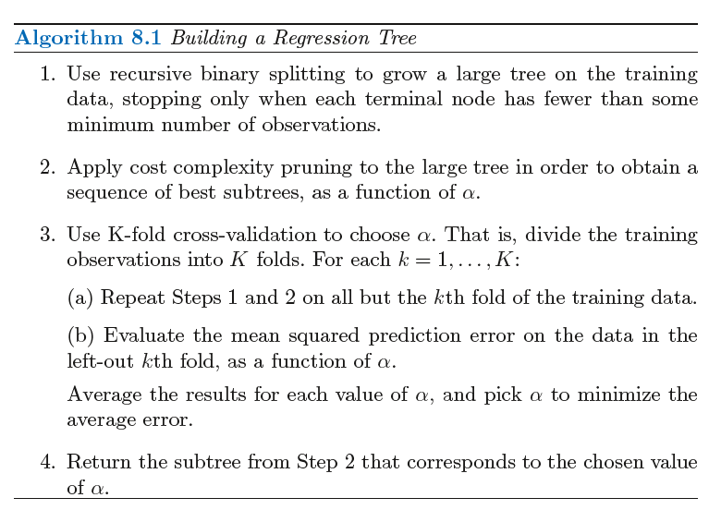
Cost Complexity Pruning
α controls the complexity of the model
Minimize
When α = 0
subtree T = To
As α increases
higher cost → smaller subtree
trade-off:
less complexity & fits to training data
Notes:
I When α = 0, then the subtree T will simply equal To, because then it just measures the training error.
However, as α = 0 increases, there is a price to pay for having a tree with many terminal nodes, and so it will be minimized for a smaller sub-tree.
If you have seen the lasso, (2) is similar to it in the sense the ways the lasso controls the complexity of the linear model.
As α = 0 increases from 0 in (2), branches are pruned from the tree in a nested and predictable way (resulting in the whole sequence of subtrees as a function of α = 0 is easy).

Slide 40
Reference
Teaching Slides
Text Book: An Introduction to Statistical Learning with applications in R,Gareth James, Springers
http://www2.stat.duke.edu/~rcs46/lectures_2017/08-trees/08-tree-regression.pdf
http://www.statsoft.com/textbook/classification-and-regression-trees
https://lagunita.stanford.edu/c4x/HumanitiesScience/StatLearning/asset/trees.pdf
RainJacket Image:https://ml.berkeley.edu/blog/2017/12/26/tutorial-5/
Regression Charts: Anders Munk-Nielsen, Department of Economics, University of Copenhagen

